Slide 1
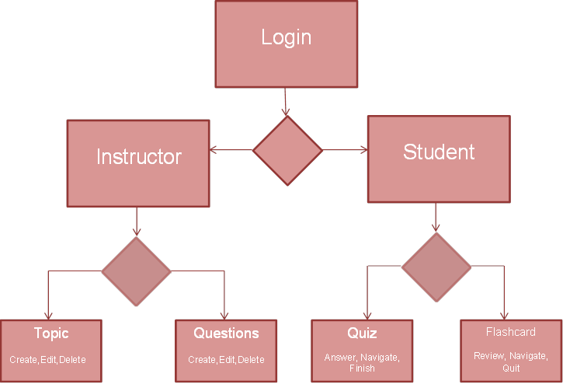
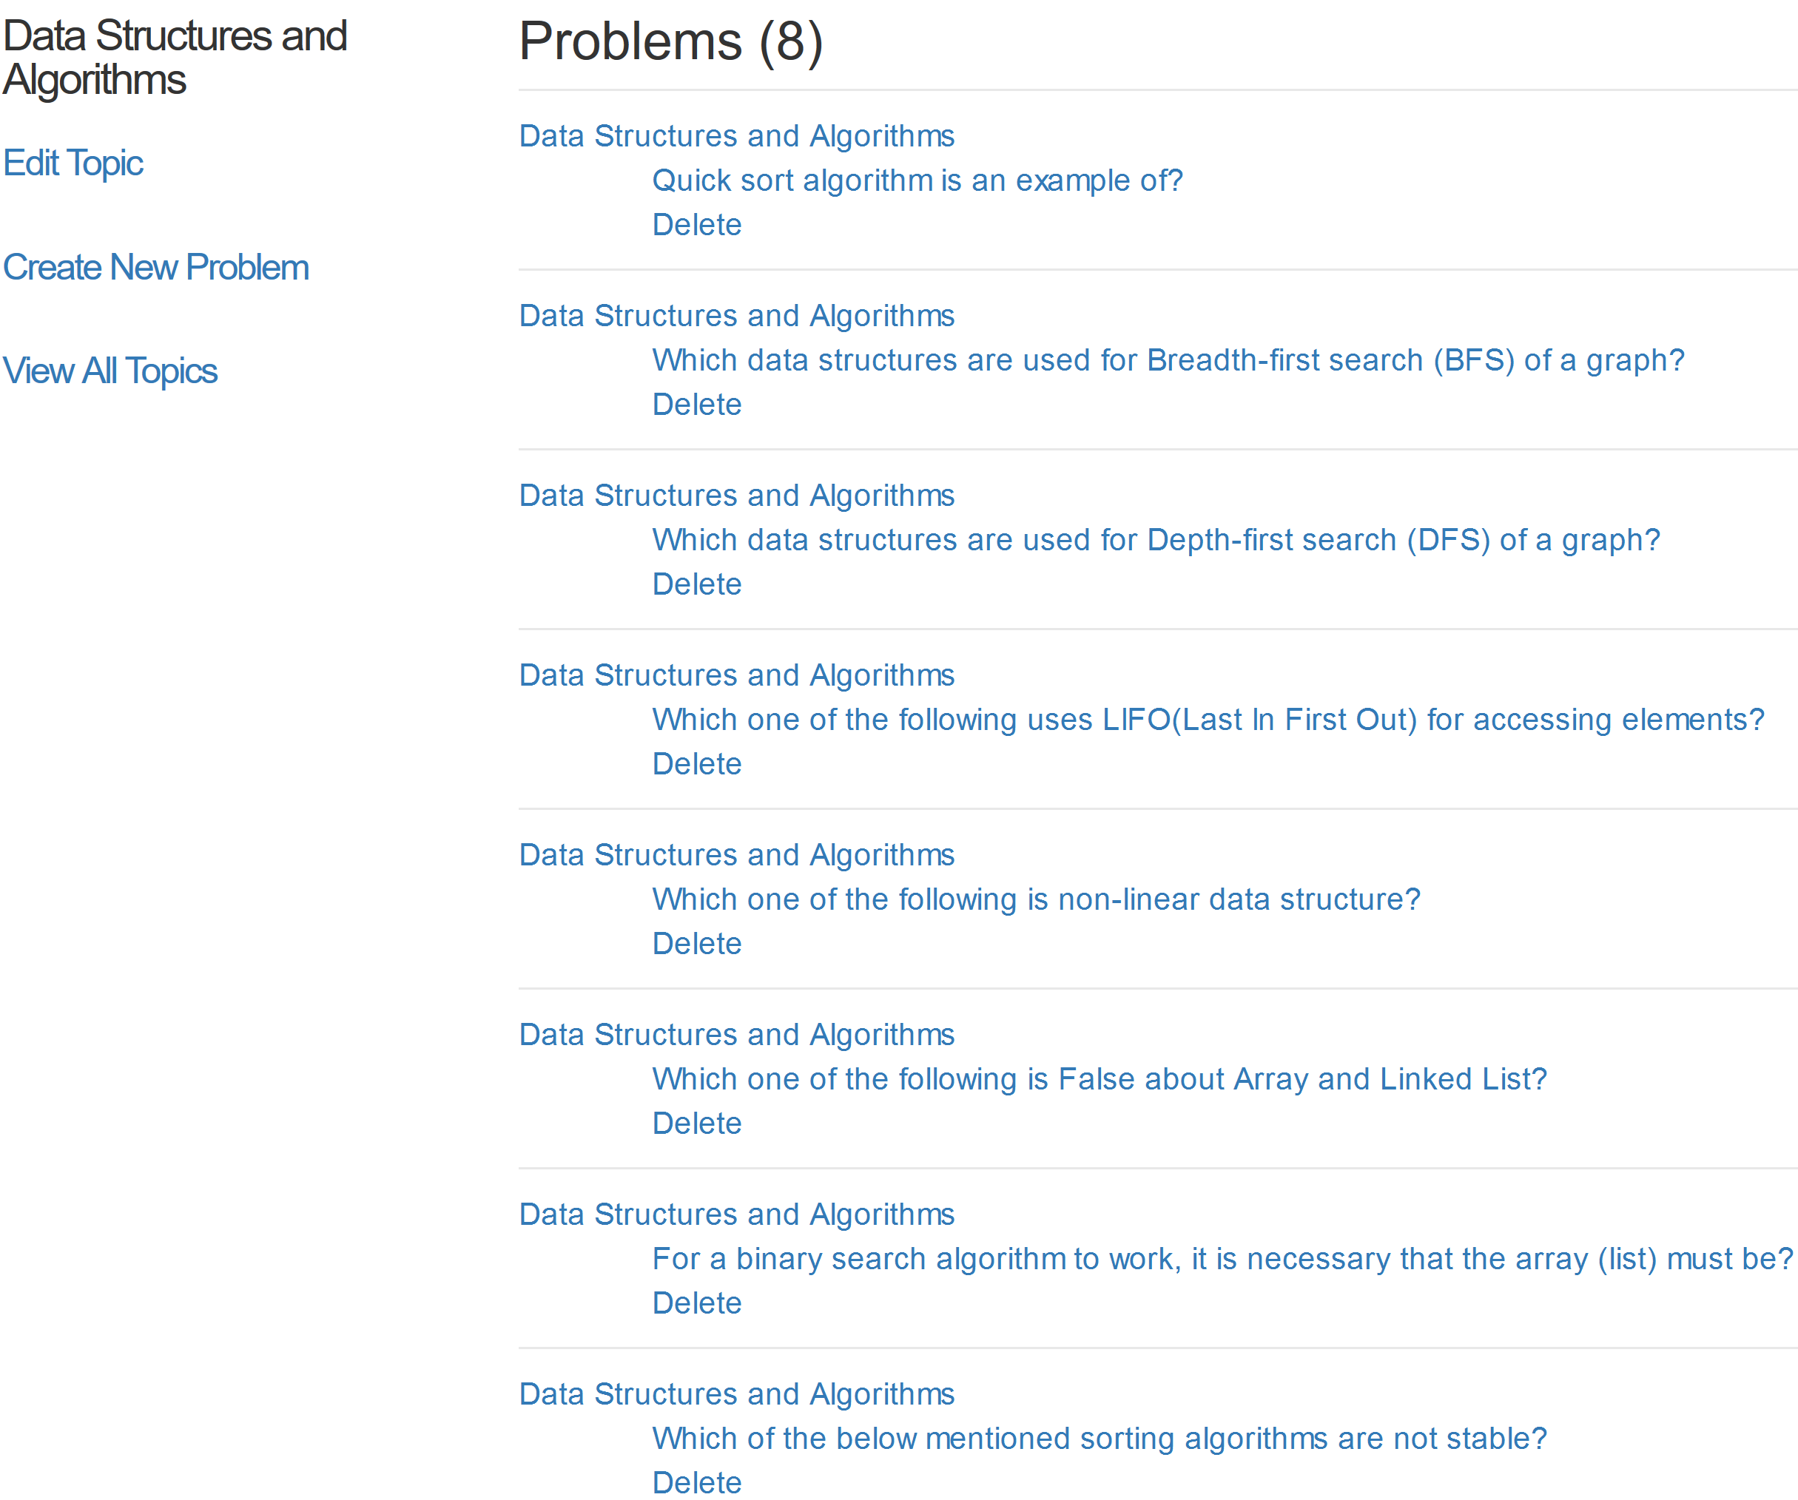
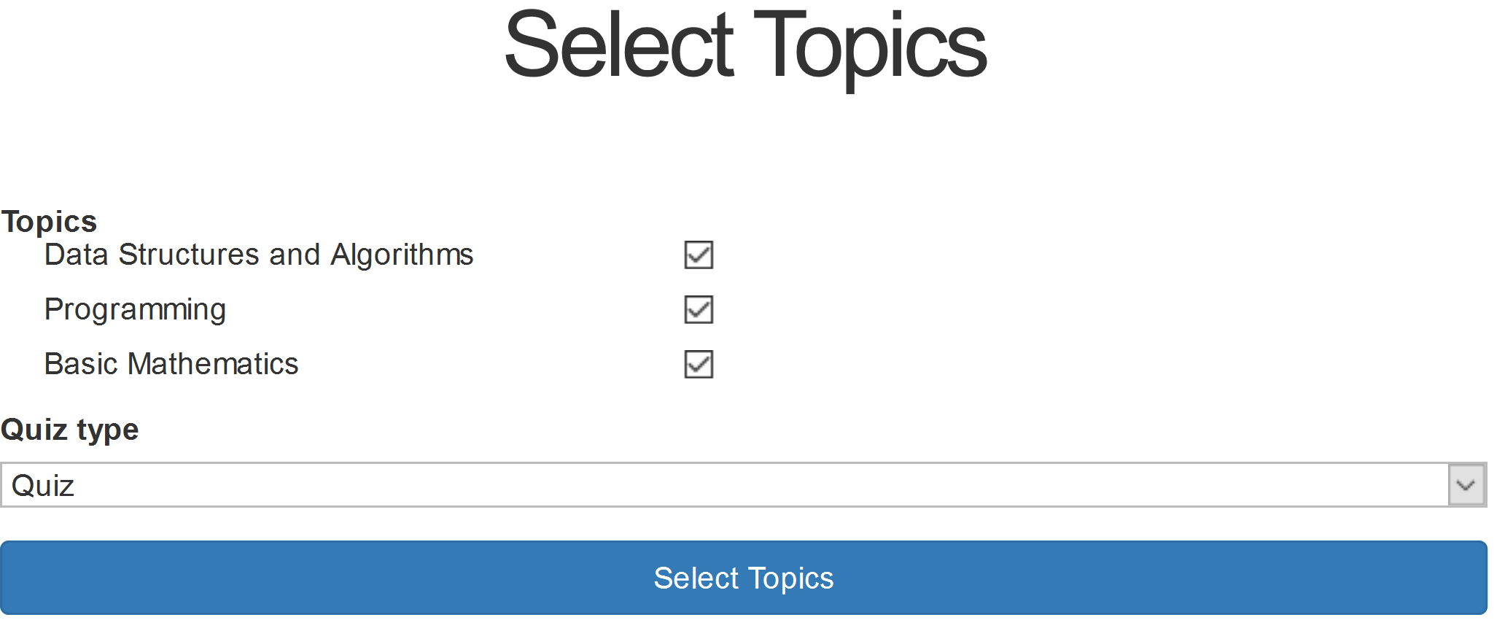
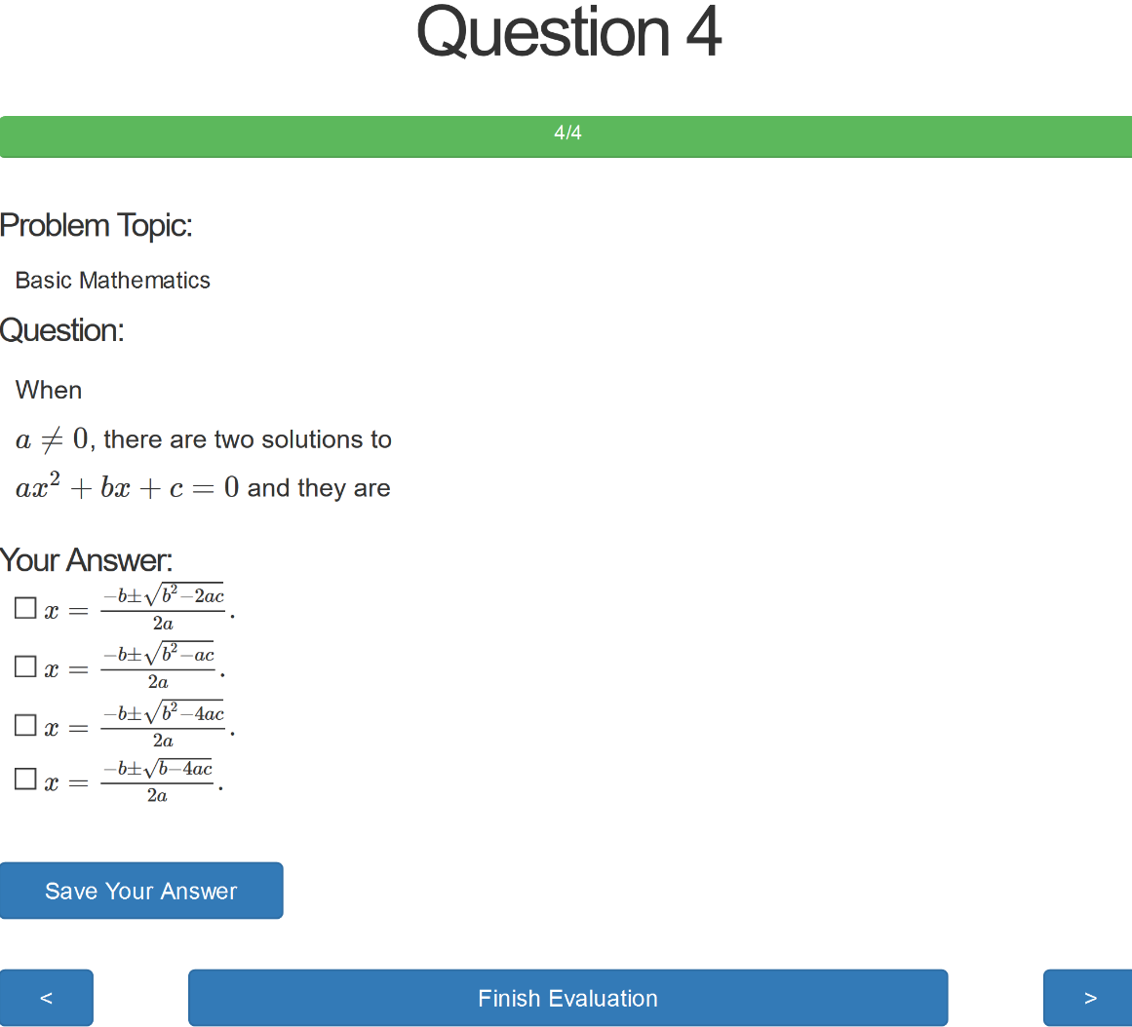
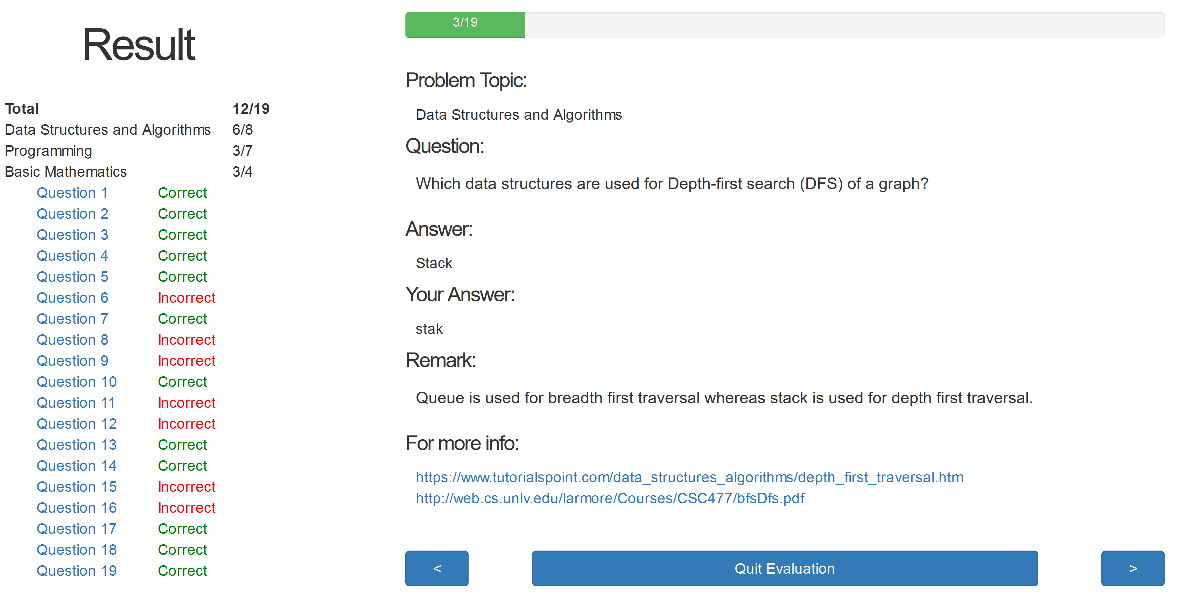
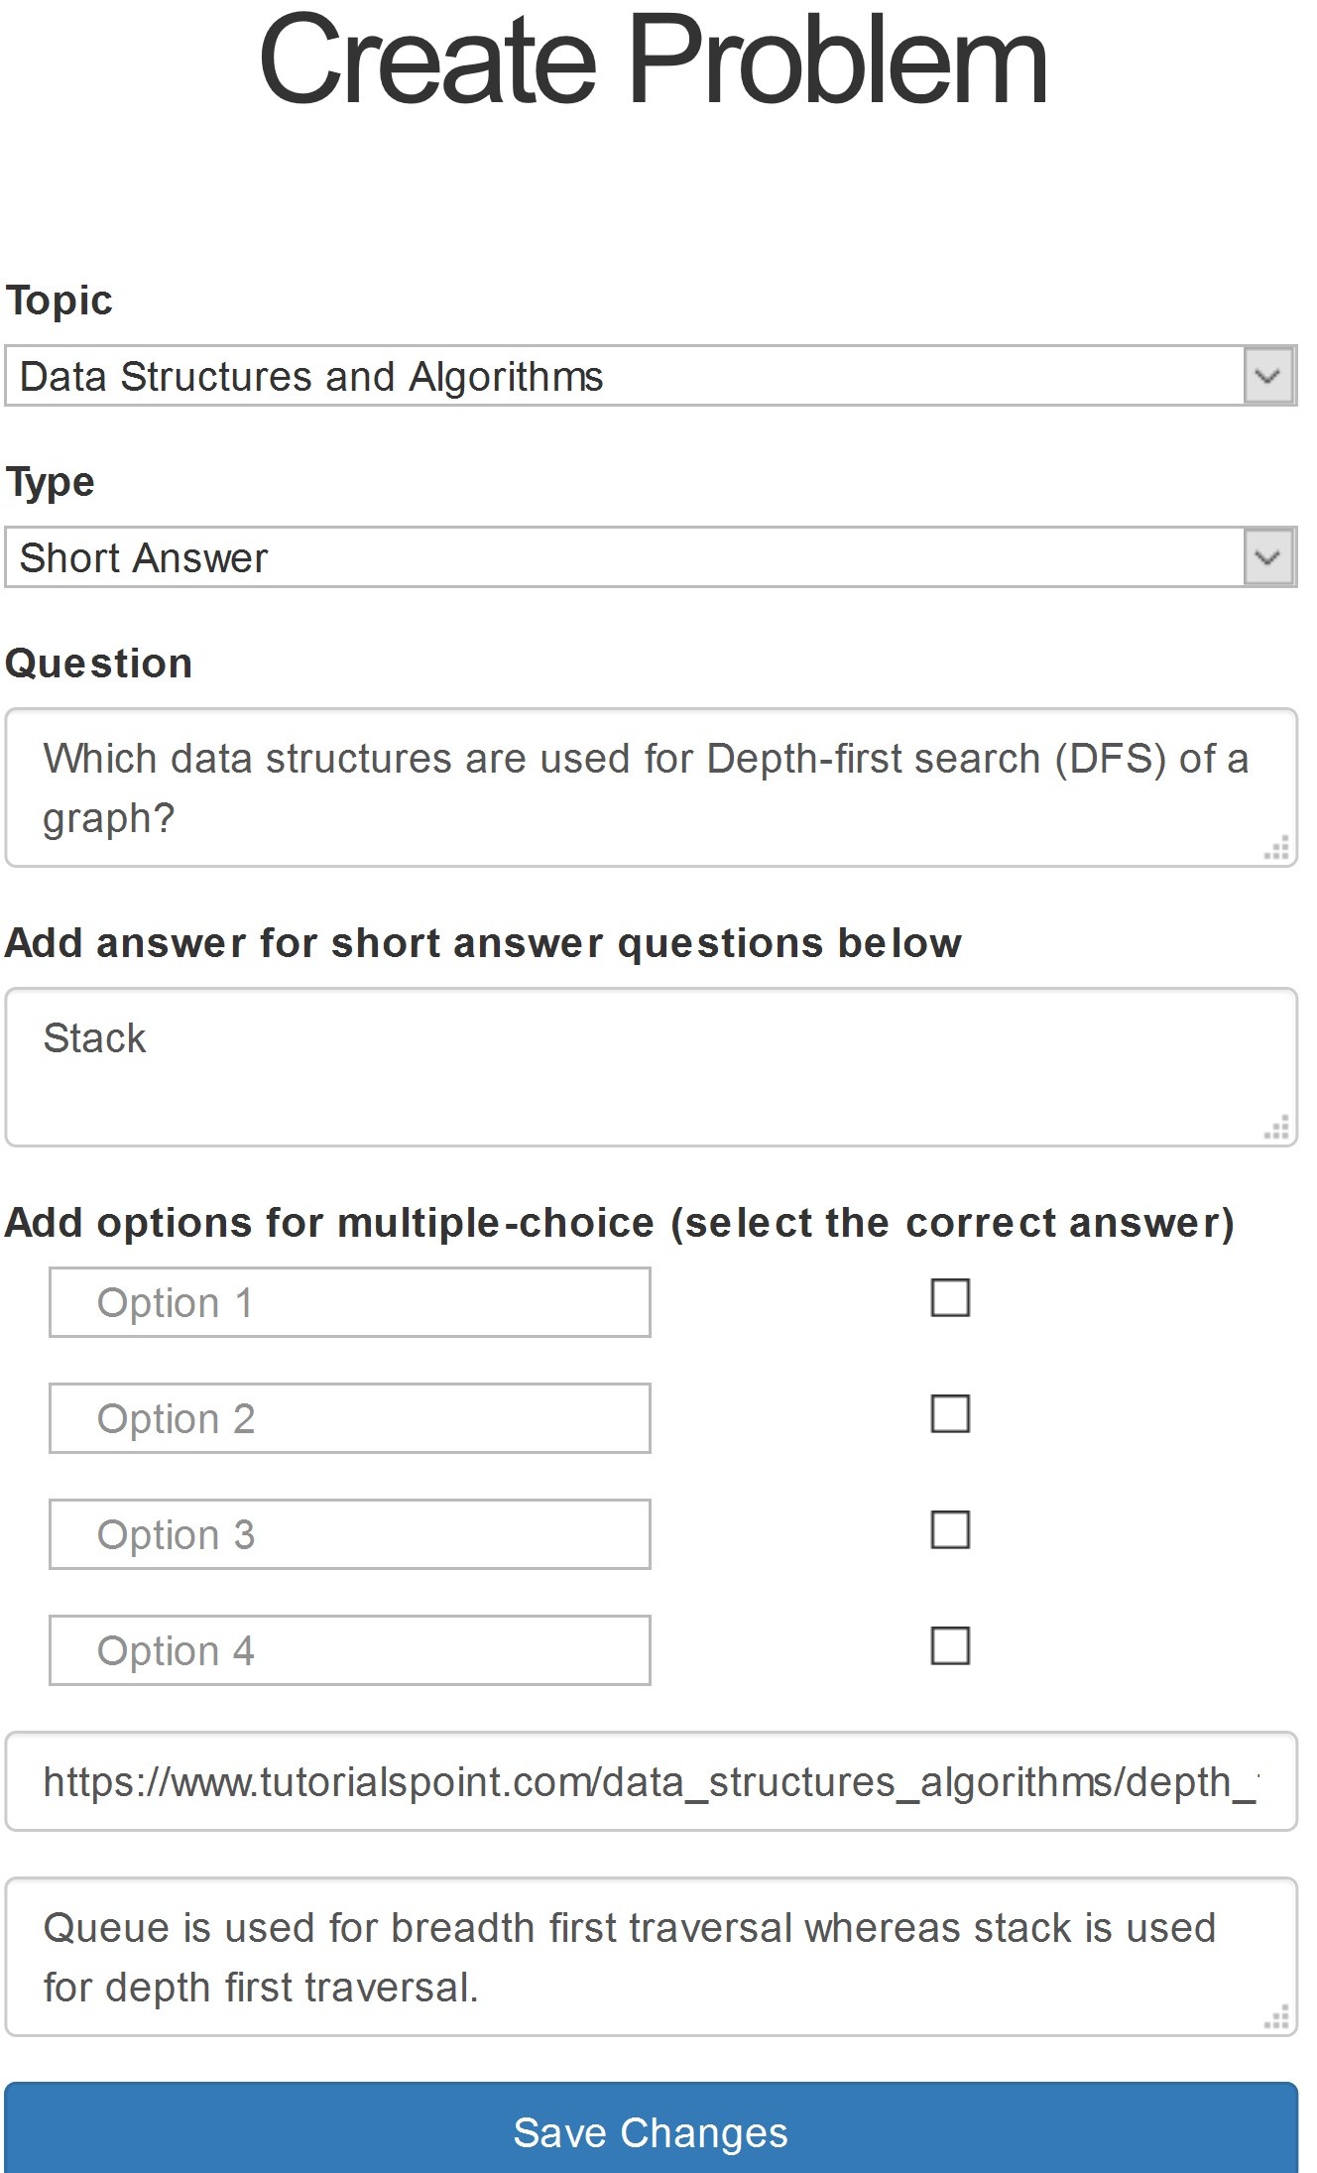
CSCE 625 (Artificial Intelligence) Self-Evaluation Website
Aditya Kumar, Akhila Mangipudi, Mayukh Roychowdhury, Sarwesh Krishnan, Vihang Patel, Yashwanth Reddy
Introduction
Design Flow
Goal: To help students interested in taking CSCE 625 evaluate their background.
Stakeholders: Instructors of CSCE 625, teaching assistants, and prospective students.
Our website allows faculty to create questions that will be answered by the students to evaluate themselves. On finishing the quiz, students are provided with a feedback and explanations for answers.
Features
Instructors:
Can login and add/edit/update questions and topics
Can choose between a multiple-choice question or short answer type question
Can add math in the questions
Can recover passwords
Students:
Can take the quiz and evaluate their performance using the feedback and remarks generated at the end
Can select the topics they want be tested on
Can go through the questions like flashcards
Faculty Portal
Student Portal
Students can choose topics they wish to be tested in the quiz and the quiz type, flashcards or quiz. Students can look at one question at a time and their progress in the green bar at the top. They can either choose the option(s) or enter the answer depending on the question’s type. They can navigate to the previous or next question and finish the quiz once done.
On clicking ‘Finish Evaluation’, a report showcasing performance across all topics is showed. To help students learn, they are also provided with useful remarks/links. We have used fuzzy matching to evaluate if the answer entered by the student is close to the actual answer.
Instructors can view all the topics, create a new topic, edit its name, and even delete it. They can view all problems belonging to a particular topic (see the above picture). A question can be deleted right away by clicking ‘Delete’. It can also be edited by first clicking on the question and then going to the edit link. A new problem in this topic can be created by clicking the link in the left sidebar.
Instructors can create either a multiple-choice or short answer type question. They can enter LaTex equations by wrapping them in $ or $$ delimiters. They can add choices and provide the correct choice, or enter the correct answer depending on the question’s type. They can also add related links and remarks to help students learn after the quiz is completed.
Challenges faced
Even though addition of equations looked straightforward using the open-source library called MathJax, getting it to work correctly took us some time. We faced problems displaying equations during navigation between the questions.
As Heroku doesn’t provide a free SMTP service, we came up with a workaround to support password recovery.
The automatic deployment feature of Heroku never worked for us and we always had to perform manual deployment.
Conclusion
Acknowledgement
Overall, we improved the already existing self-evaluation portal by adding several new features. We made considerable changes to the user interface, especially the creation and viewing of questions. We have done extensive testing on all the new and previously existing features and made the product more robust.
We would like to thank Dr. Walker for allotting us this project, acting as the primary stakeholder, and guiding us throughout.

